Slide 1

Science Market
Sound and Feedback effect
Presented by:
Lin & Jonathan

Slide 2

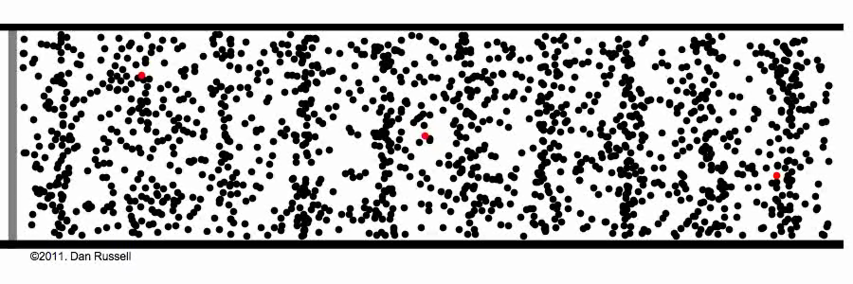
What is sound?
“Sound is a vibration that propagates as a typically audible
mechanical wave of pressure and displacement,
through a medium such as air, and water.”

Slide 3
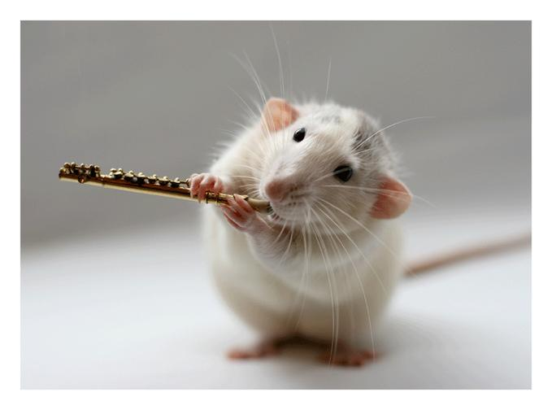
DEMO
TIME TO PLAY SOME FLUTE!

Slide 4
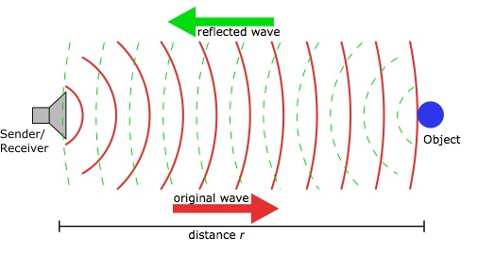
Example of Feedback:
the echo phaenomenom

Slide 5
And now....
an experiment with you!

Slide 6

…. to start, a small challenge
Read the text in the next slide!
... No interruptions!

Slide 7
Acoustics is the interdisciplinary science that deals with the study of all mechanical waves in gases, liquids, and solids including topics such as vibration, sound, ultrasound and infrasound.

Slide 8

…. and now, read it again with the headphone.
... No interruptions!

Slide 9

Now, a more challenging task
Time to sing!

Slide 10

The effect of the Feedback on the acoustic source
No feedback
Acoustic source: you

Slide 11
The effect of the Feedback on the acoustic source
Lagged voice feedback
Acoustic source: you

Slide 12
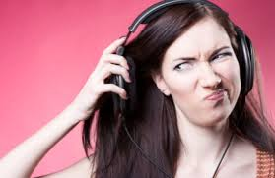
Feedback can make the source ‘unstable’!
Lagged voice feedback
Acoustic source: you

